Slide 1


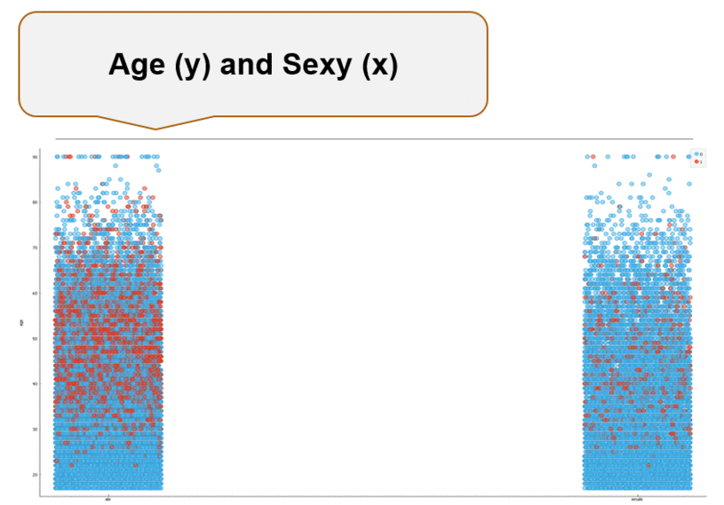
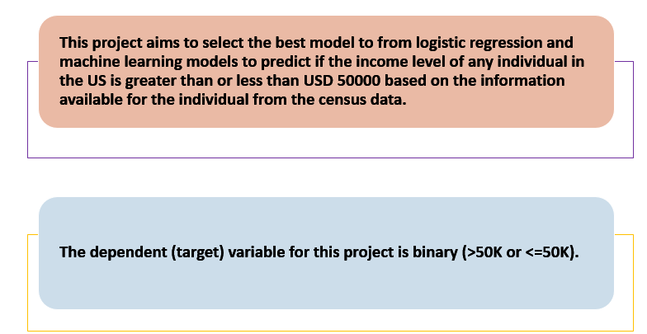
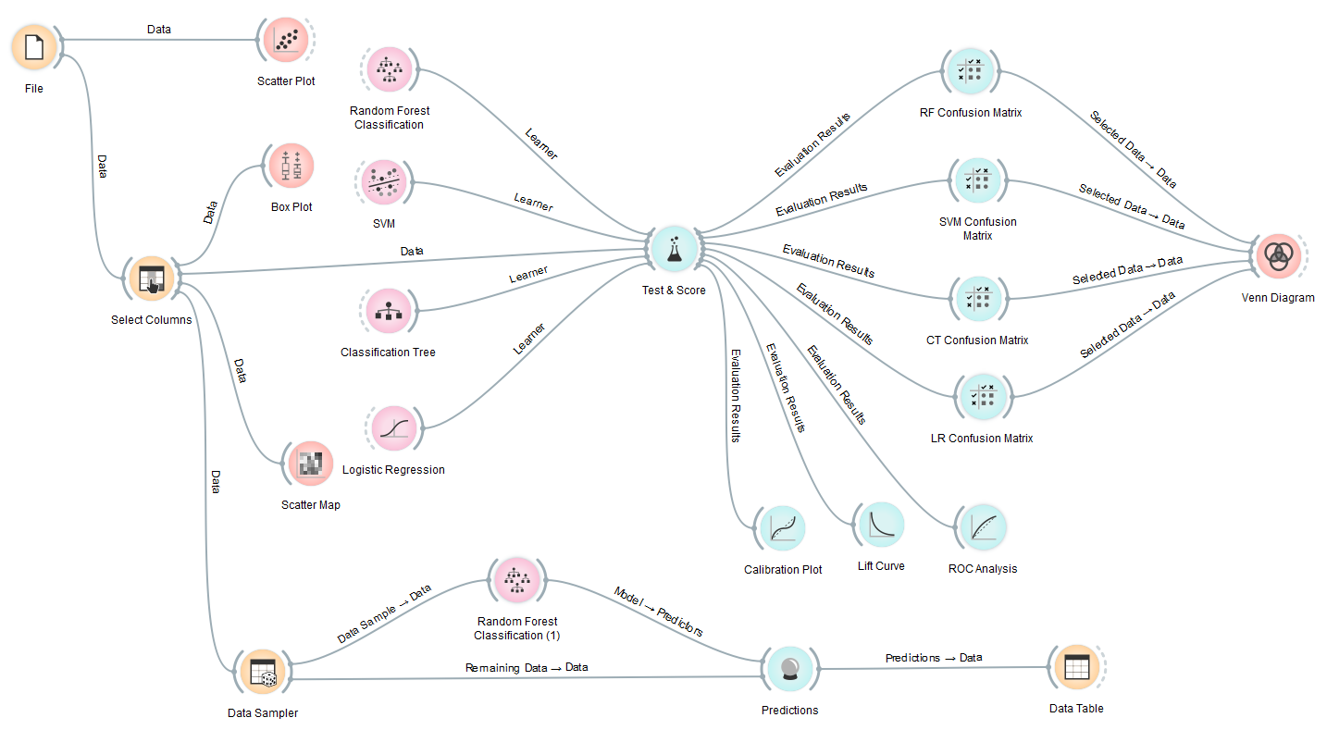
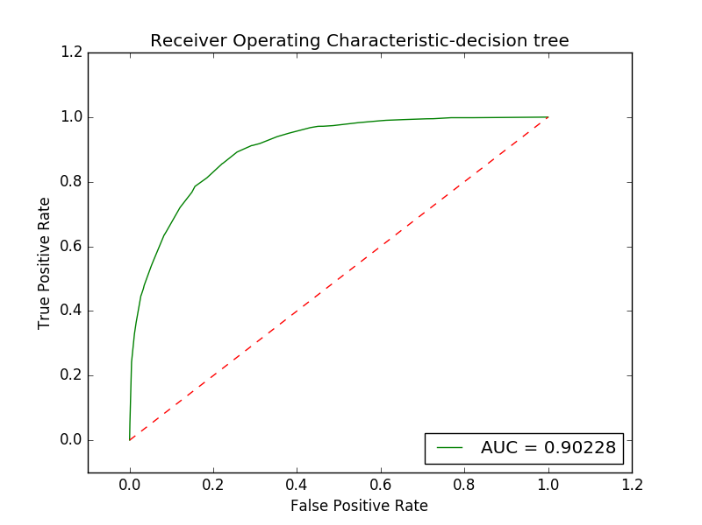
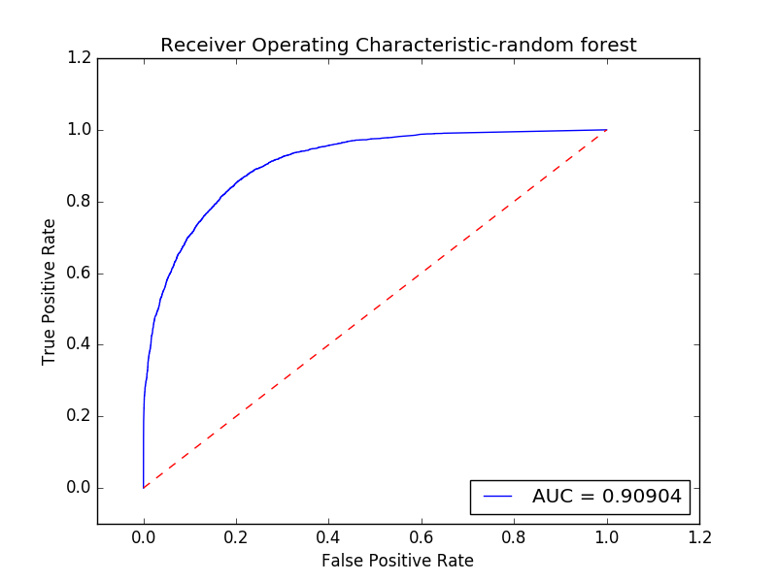
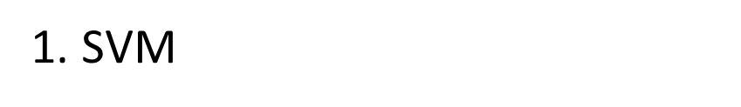
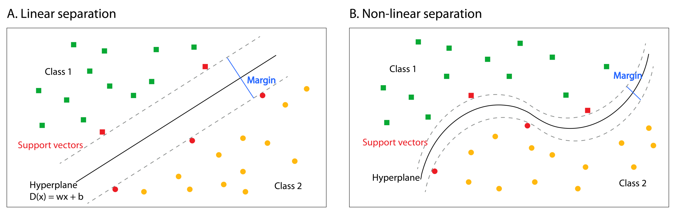
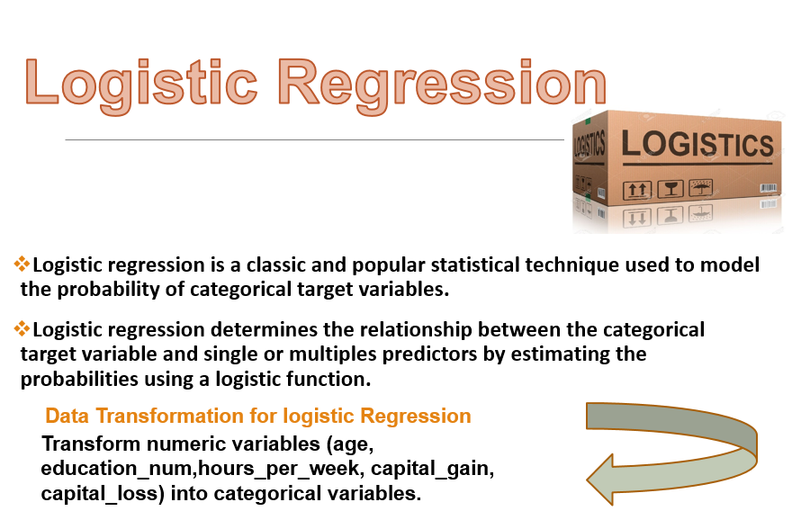

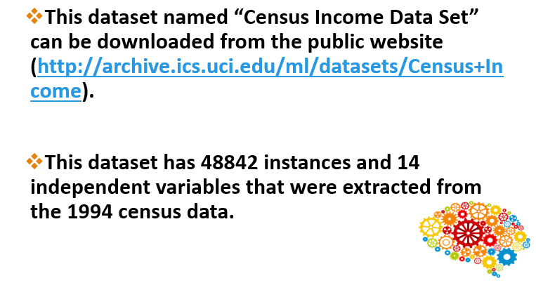
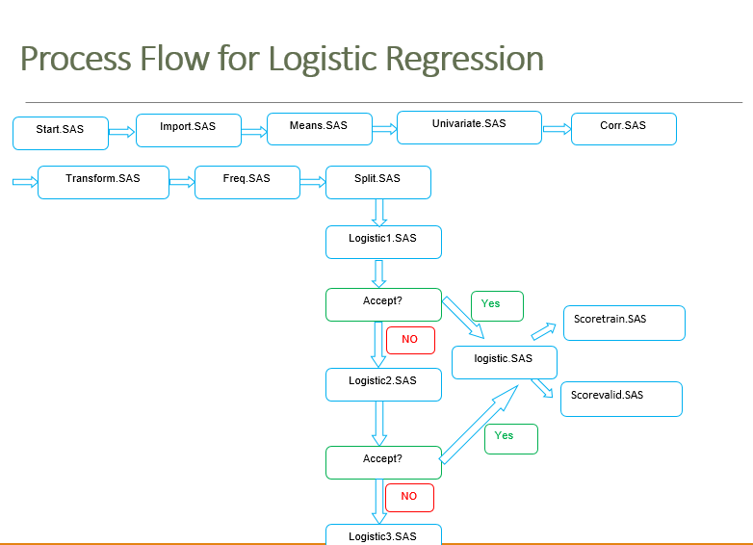
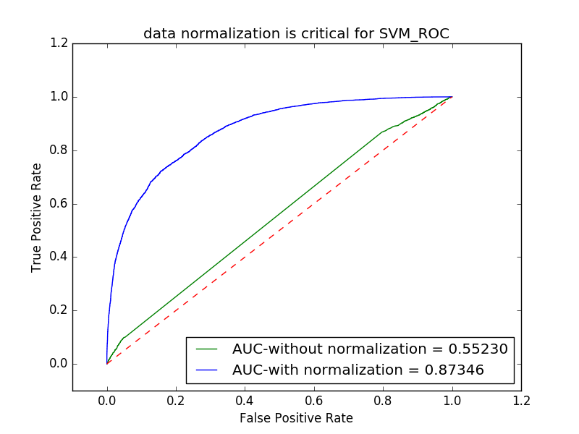
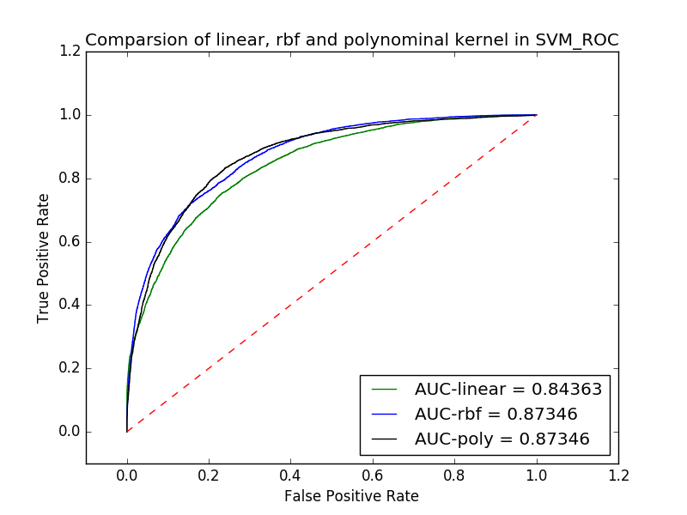
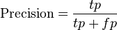
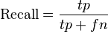
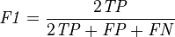
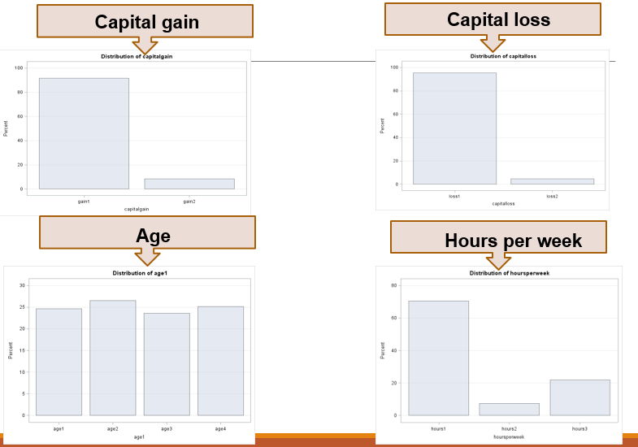
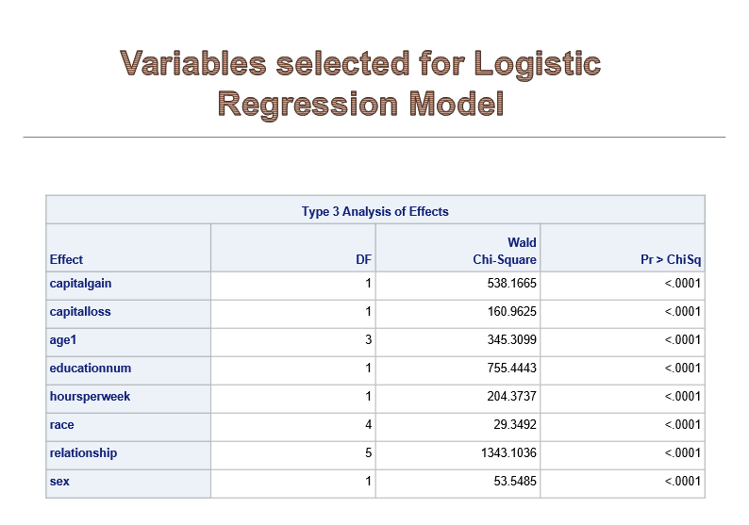
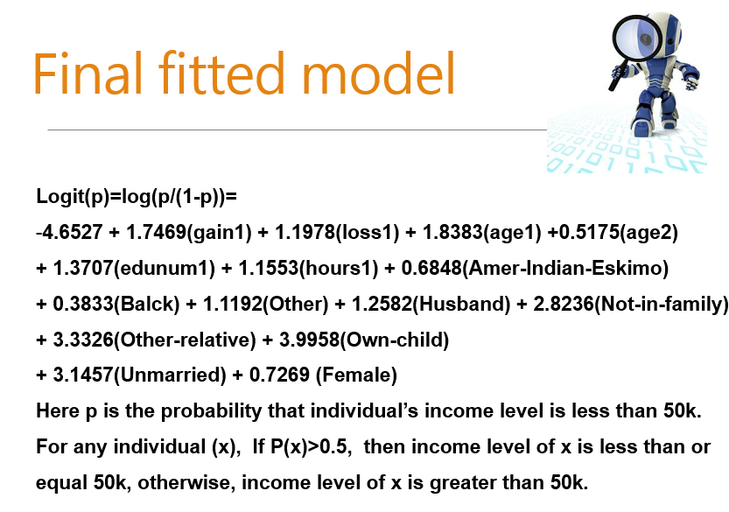
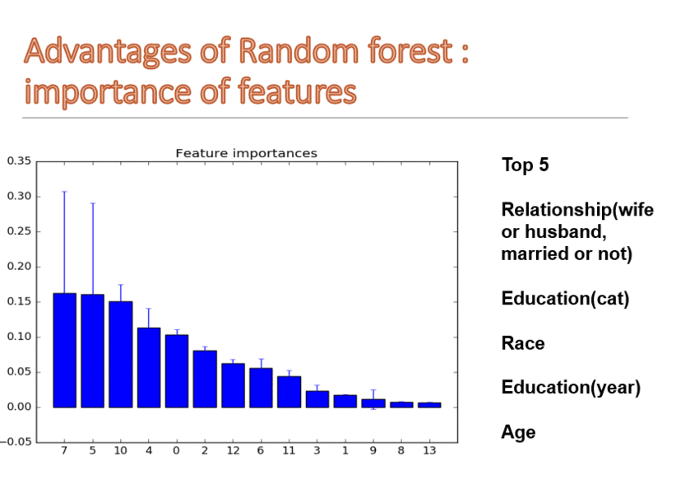
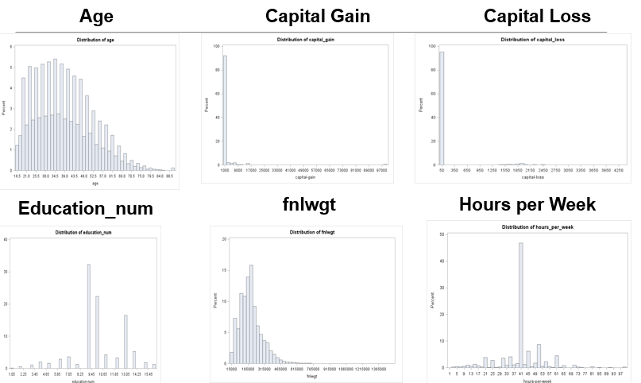
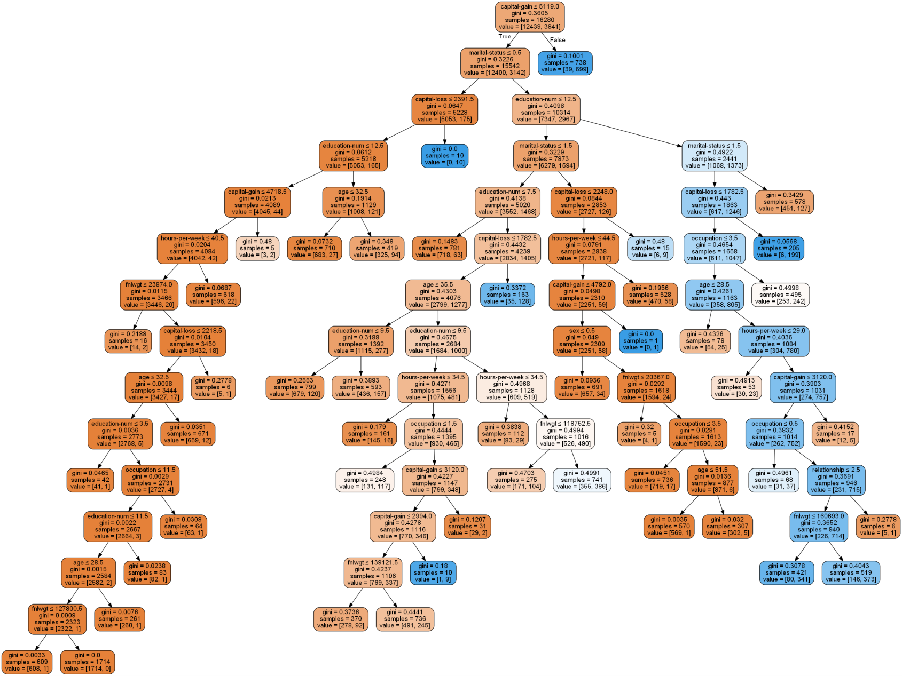

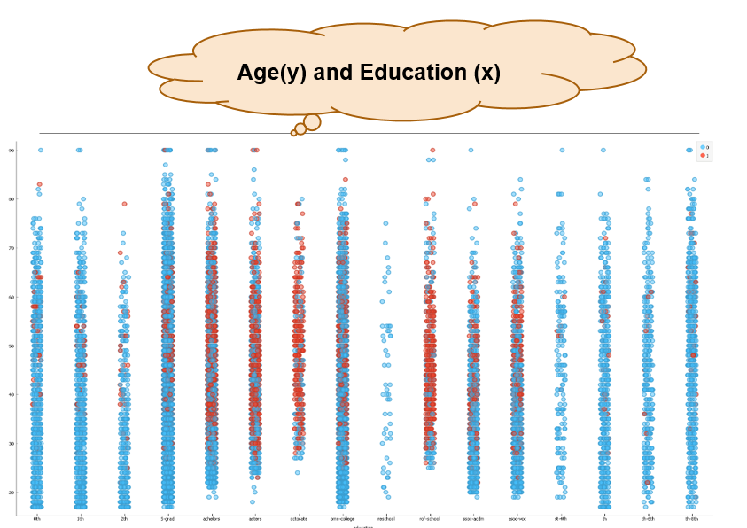
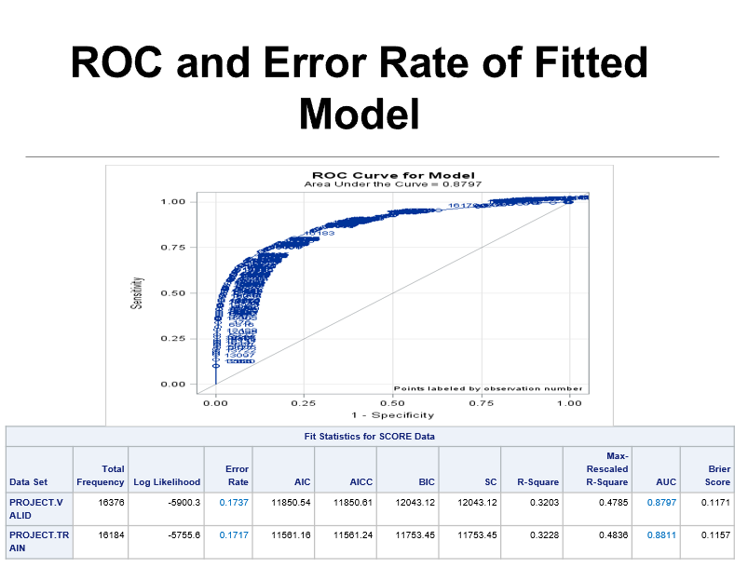
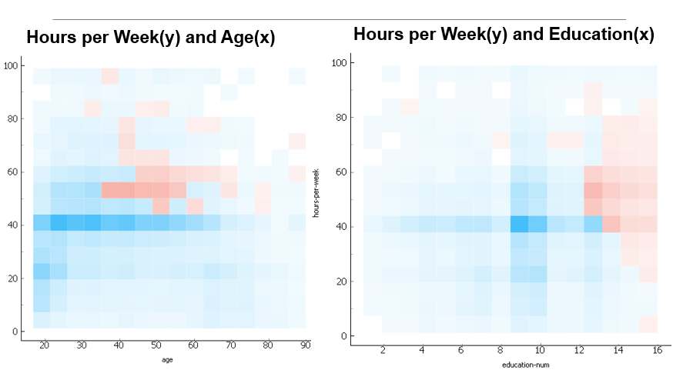
ROC-Decision tree VS random forest
COMPARISON OF LOGISTIC REGRESSION MODEL WITH MACHNE LEARNING MODELS TO PREDICT US INDIVIDUAL’S INCOME LEVEL
Team members: Qiudong Deng, Donghui Li, Liyuan Liu, Peilin Zhou, Yiyun Zhou
Workflow
Distribution of Data
Machine Learning models using Scikit-learn machine learning library in Python
KeyCode:RandomForestClassifier(criterion='entropy', max_features=5)
Confusion Matrix-decision tree VS random forest
Data exploration
 | Decision Tree |  |  | random forest
 | precision | recall | f1-score | precision | recall | f1-score
0 | 0.87 | 0.94 | 0.91 | 0.89 | 0.93 | 0.91
1 | 0.75 | 0.58 | 0.65 | 0.74 | 0.62 | 0.68
average | 0.84 | 0.85 | 0.84 | 0.85 | 0.86 | 0.85
Distribution of Data
Key code
svm.SVC(kernel='linear',probability=True)
Decision Tree and Random forest
Evaluation and Conclusion
Key code
DecisionTreeClassifier(criterion='gini', min_samples_split=800,max_depth=None, random_state=99)

